Slide 1


CRIME
IN
BOSTON
By.
MARIO BILLY GUNAWAN
JCDSOL-009-022

Slide 2


TABLE
01
Data Profile
OF CONTENTS
Background &
Problem Statements
02
Insights &
Recommendations
03
04
Conclusion

Slide 3



Involved Parties
MARIO BILLY GUNAWAN
As Data Analyst Consultant
BOSTON POLICE DEPARTMENT
As User

Slide 4




DATA PROFILE
Datasets: crime.csv and offense_codes.csv
Time Span : June 14, 2015 - September 3, 2018
Location : Boston, Massachusetts, USA
Data Source :
kaggle

Slide 5





COLUMNS
Primary Key | Combination of INCIDENT_NUMBER and OFFENSE_CODE
Offense Detail | OFFENSE_CODE, OFFENSE_CODE_GROUP, and OFFENSE_DESCRIPTION
Incident Location | DISTRICT, DISTRICT_NAME, Location (Lat & Long)
Incident Details | DATE, TIME, SHOOTING (Y/N), UCR_PART
Unutilized Column | REPORTING_AREA and STREET

Slide 6


BACKGROUND
There was a 54% jump in homicide incidents in 2020 as many as 57 cases compared to 37 cases that occurred in 2019, which is the lowest level in 20 years.
SOURCE: BOSTON HERALD: CRIME & PUBLIC SAFETY

Slide 7
PROBLEM
STATEMENTS
1. What types of offenses occurred the most in Boston from 2015-2018?
2. Which districts along with the location points that are most prone to an
incident in Boston?
3. How is the trend of Homicide incidents and incidents that involving shootings
in Boston from 2015-2018?
4. On which days do the most incidents occured in Boston?
5. Is there a tendency for more incidents to occured at night?
6. What types of violations often occur based on the category of each UCR Part?

Slide 8






INSIGHTS & RECOMMENDATION

Slide 9

Offense Types That Occured The Most in Boston
OFFENSE_CODE | OFFENSE_CODE_GROUP | OFFENSE_DESCRIPTION | Number of Incident | Percentage of Incident(%)
3006 | Medical Assistance | SICK/INJURED/MEDICAL - PERSON | 18783 | 5.89
3115 | Investigate Person | INVESTIGATE PERSON | 18749 | 5.88
3831 | Motor Vehicle Accident Response | M/V - LEAVING SCENE - PROPERTY DAMAGE | 16323 | 5.12
1402 | Vandalism | VANDALISM | 15153 | 4.75
802 | Simple Assault | ASSAULT & BATTERY | 14797 | 4.64

Slide 10
Offense Types That Occured The Most in Boston
INSIGHTS | RECOMMENDATION
It can be seen that medical assistance to sick or injured people is the most reported incident in Boston with 18.783 incidents with a percentage of 5,89%. | The Boston Police Department (BPD) should provide basic training to all patrol personnel on duty with first aid treatment. This is to anticipate delays due to road conditions that are difficult to predict.
It can be seen that medical assistance to sick or injured people is the most reported incident in Boston with 18.783 incidents with a percentage of 5,89%. | The Boston Police Department (BPD) should provide basic training to all patrol personnel on duty with first aid treatment. This is to anticipate delays due to road conditions that are difficult to predict.
It can be seen that medical assistance to sick or injured people is the most reported incident in Boston with 18.783 incidents with a percentage of 5,89%. | 7 Steps of First Aid Treatment in a Traffic Accident: Check the situation on the scene, Get medical help immediately, Make sure the victim is not mobbed, Do not move the victim if they are seen to have internal injuries, Stop bleeding, Overcome post-accident shock, and Always check the casualty's response, respiration, and pulse
It can be seen that medical assistance to sick or injured people is the most reported incident in Boston with 18.783 incidents with a percentage of 5,89%. | 7 Steps of First Aid Treatment in a Traffic Accident: Check the situation on the scene, Get medical help immediately, Make sure the victim is not mobbed, Do not move the victim if they are seen to have internal injuries, Stop bleeding, Overcome post-accident shock, and Always check the casualty's response, respiration, and pulse
It can be seen that medical assistance to sick or injured people is the most reported incident in Boston with 18.783 incidents with a percentage of 5,89%. | The Boston Police Department (BPD) can also prepare a first aid kit in each patrol vehicle, so it can be used in the case of an accident.

Slide 11

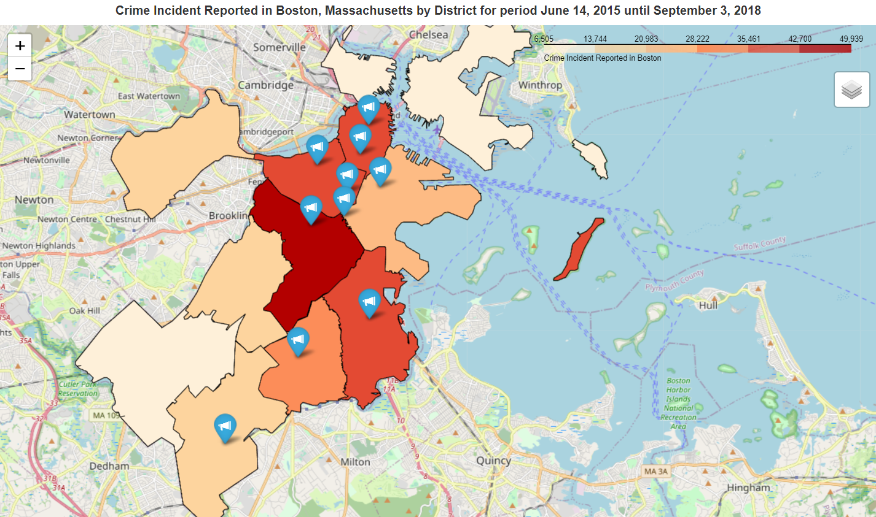
Districts and The Location Points That are Most Prone to an Incident in Boston

Slide 12
Districts and The Location Points That are Most Prone to an Incident in Boston
INSIGHTS | RECOMMENDATION
It can be seen that the most incidents that occurred were in the District of Roxbury (B2) with a dark red sign of 49,939 incidents with a percentage of 15.74%. | The Boston Police Department (BPD) should add more personnel and patrol schedules to oversee 5 districts with most incidents happened between 35,000 and 49,000 incidents, there are districts of Roxbury (B2), Dorchester (C11), South End (D4) , Downtown (A1), and Mattapan (B3).
While the least number of incidents occurred in the Charlestown District (A15) with a white cream sign of 6,505 incidents and a percentage of 2.04%. | The Boston Police Department (BPD) should add more personnel and patrol schedules to oversee 5 districts with most incidents happened between 35,000 and 49,000 incidents, there are districts of Roxbury (B2), Dorchester (C11), South End (D4) , Downtown (A1), and Mattapan (B3).
There are 4 locations where the highest number of incidents are located close together in 3 different districts, there are districts of Roxbury (B2), South Boston (C6), and South End (D4). | The Boston Police Department (BPD) should form a special task force to investigate whether there is a connection between 4 adjacent location points with the highest total incidents in 3 different districts. If there is an organized criminal group in that area or is it just a coincidence.

Slide 13

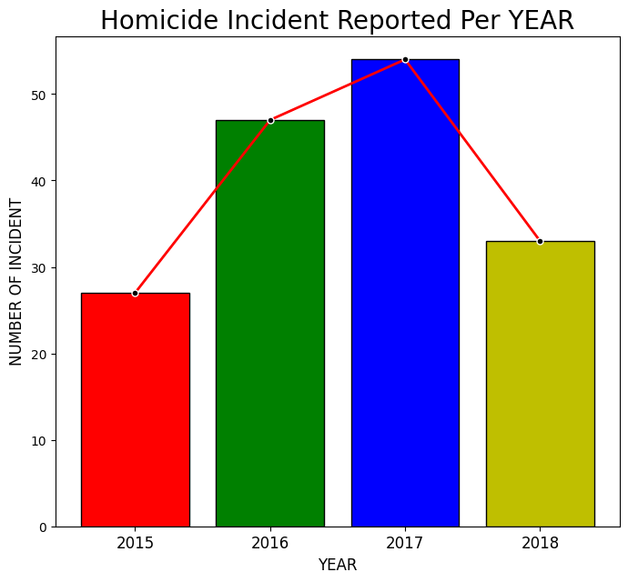
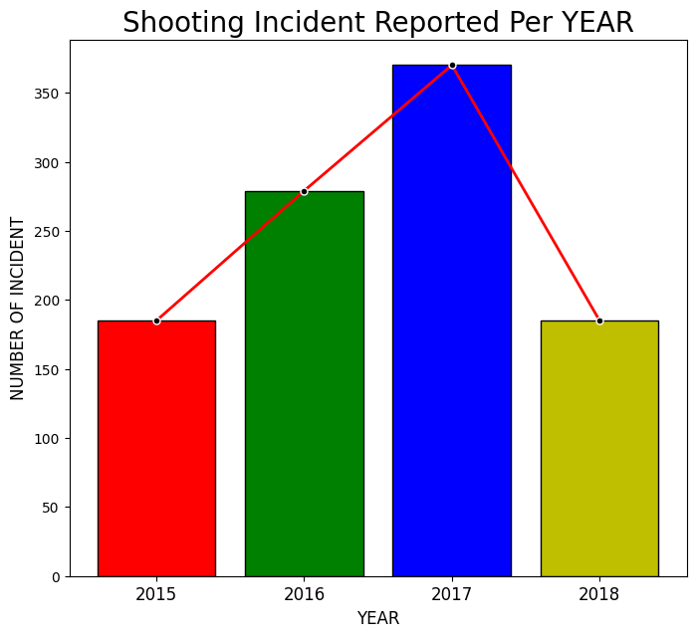
The Trend of Homicide Incidents and Incidents That Involving Shootings in Boston from 2015-2018

Slide 14
The Trend of Homicide Incidents and Incidents That Involving Shootings in Boston from 2015-2018
INSIGHTS | RECOMMENDATION
The number of incidents of Homicides and shootings tends to be fluctuate from 2015 to 2018. From 2015 to 2017, the number of incidents has been increased and from 2017 to 2018, the number of incidents has decreased quite drastically. | The Boston Police Department is advised to review the preventive and repressive strategies that were previously successful in 2017 to 2018. Because there is a high probability that illegal weapons can be obtained again easily and the level of supervision of gang members is also decreased. War between gangs could be one of the factors causing the Homicide incidents to increase again. According to U.S. Attorney's Office, District of Massachusetts, in 2020 there were 31 NOB gang members who were allegedly involved with various criminal activities such as Homicide, attempted Homicide, and illegal firearms crimes.
This shows that preventive and repressive measures against the use of firearms have been successful in reducing the number of shooting crimes by up to 185 incidents. | The Boston Police Department is advised to review the preventive and repressive strategies that were previously successful in 2017 to 2018. Because there is a high probability that illegal weapons can be obtained again easily and the level of supervision of gang members is also decreased. War between gangs could be one of the factors causing the Homicide incidents to increase again. According to U.S. Attorney's Office, District of Massachusetts, in 2020 there were 31 NOB gang members who were allegedly involved with various criminal activities such as Homicide, attempted Homicide, and illegal firearms crimes.
In 2018 there were 33 incidents of Homicide. However, there was a jump of 54% in 2020 from the previous year's 37 incidents. This indirectly indicates that incidents involving the use of firearms have also increased. | The Boston Police Department is advised to review the preventive and repressive strategies that were previously successful in 2017 to 2018. Because there is a high probability that illegal weapons can be obtained again easily and the level of supervision of gang members is also decreased. War between gangs could be one of the factors causing the Homicide incidents to increase again. According to U.S. Attorney's Office, District of Massachusetts, in 2020 there were 31 NOB gang members who were allegedly involved with various criminal activities such as Homicide, attempted Homicide, and illegal firearms crimes.

Slide 15

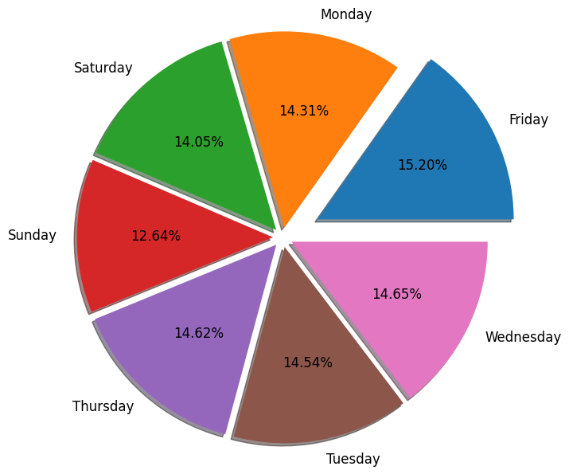
The Days That The Most Incidents Occured
in Boston

Slide 16
The Days That The Most Incidents Occured
in Boston
INSIGHTS | RECOMMENDATION
Based on the pie chart, it can be seen that many incidents of violations in the City of Boston occurred on Fridays with a percentage of 15.20%. Followed by Wednesday and Thursday with respective percentages of 14.65% and 14.62%. | The Boston Police Department (BPD) was advised to re-evaluate the police personnel patrol schedule. Where patrol activities on Wednesday, Thursday and Friday should be prioritized compared to Saturday and Sunday. By adding more patrol schedules on these days it is hoped that it can reduce the number of incidents per day and can create a safer situation for the citizens of the City of Boston.
Saturday and Sunday were the days with the fewest incidents of violations with percentages of 14.05% and 12.64%. | The Boston Police Department (BPD) was advised to re-evaluate the police personnel patrol schedule. Where patrol activities on Wednesday, Thursday and Friday should be prioritized compared to Saturday and Sunday. By adding more patrol schedules on these days it is hoped that it can reduce the number of incidents per day and can create a safer situation for the citizens of the City of Boston.
This shows that there are more incidents of violations in the City of Boston on weekdays than on weekends. | The Boston Police Department (BPD) was advised to re-evaluate the police personnel patrol schedule. Where patrol activities on Wednesday, Thursday and Friday should be prioritized compared to Saturday and Sunday. By adding more patrol schedules on these days it is hoped that it can reduce the number of incidents per day and can create a safer situation for the citizens of the City of Boston.

Slide 17

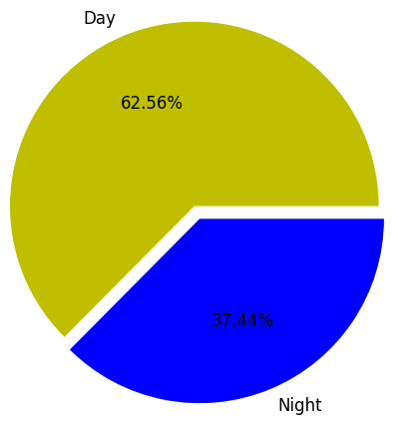
If There is a Tendency for More Incidents
To Occured at Night
Hypothesis Testing
H0 : Violation incidents tend to occur more than 50% at night
H1 : Violation incidents tend not to occur more than 50% at night
Results:
p-value = 0.06420632876812224
Reject H0, Violation incidents tend not to occur more than 50% at night

Slide 18
If There is a Tendency for More Incidents
To Occured at Night
INSIGHTS | RECOMMENDATION
Based on the hypothesis testing and pie-chart graphs, it can be seen that the proportion of incidents that occurred at night was not more than during the day. This can be influenced by the activity of residents at night which is less than during the day. | Even though the proportion of incidents that occurred during the day was greater, at the night the proportion of incidents that occurred was also quite large with a percentage of 37.44%. Therefore, the Boston Police Department is advised to increase personnel and patrol routes during the night. Especially patrols in areas that prone to criminal incidents as described in point analysis number 2.
However, due to the fact that there are fewer residents' activities at night, the perpetrators have the opportunity to carry out their crimes. For the example is the incident of house burglary, which often occurs at night and many residents are already sound asleep, this can provide a greater opportunity for the perpetrator to carry out the robbery without scared to be found out by the home owner. | Even though the proportion of incidents that occurred during the day was greater, at the night the proportion of incidents that occurred was also quite large with a percentage of 37.44%. Therefore, the Boston Police Department is advised to increase personnel and patrol routes during the night. Especially patrols in areas that prone to criminal incidents as described in point analysis number 2.

Slide 19

Types of Violations That Often Occur Based on The Category of Each UCR Part
Overall
UCR_PART 1
UCR_PART | Number of Incident | Percentage of Incident (%)
Part Three | 158537 | 49.69
Part Two | 97557 | 30.58
Part One | 61625 | 19.32
Other | 1232 | 0.39
N/A | 86 | 0.03
No. | Type_of_Incident | Number of Incident | Percentage of Incident (%)
1 | LARCENY IN A BUILDING $200 & OVER | 9073 | 14.72
2 | LARCENY THEFT FROM MV - NON-ACCESSORY | 8894 | 14.43
3 | LARCENY SHOPLIFTING $200 & OVER | 7952 | 12.90

Slide 20
Types of Violations That Often Occur Based on The Category of Each UCR Part
UCR_PART 2
UCR_PART 3
No. | Type_of_Incident | Number of Incident | Percentage of Incident (%)
1 | VANDALISM | 15153 | 15.53
2 | ASSAULT & BATTERY | 14797 | 15.17
3 | THREATS TO DO BODILY HARM | 9042 | 9.27
No. | Type_of_Incident | Number of Incident | Percentage of Incident (%)
1 | SICK/INJURED/MEDICAL - PERSON | 18783 | 11.85
2 | INVESTIGATE PERSON | 18749 | 11.83
3 | M/V - LEAVING SCENE - PROPERTY DAMAGE | 16323 | 10.30

Slide 21
Types of Violations That Often Occur Based on The Category of Each UCR Part
UCR Other
UCR N/A
No. | Type_of_Incident | Number of Incident | Percentage of Incident (%)
1 | RECOVERED - MV RECOVERED IN BOSTON | 1051 | 85.31
2 | ARSON | 94 | 7.63
3 | RECOVERED STOLEN PLATE | 67 | 5.44
No. | Type_of_Incident | Number of Incident | Pecentage of Incident (%)
1 | HOME INVASION | 77 | 89.53
2 | HUMAN TRAFFICKING - COMMERCIAL SEX ACTS | 7 | 8.14
3 | HUMAN TRAFFICKING - INVOLUNTARY SERVITUDE | 2 | 2.33

Slide 22
Types of Violations That Often Occur Based on The Category of Each UCR Part
INSIGHTS | RECOMMENDATION
Based on the overall cross tabulation, it can be seen that the largest percentage of incidents is in the UCR Part 3 category with a value of 49.69% and a total of 158,537 incidents | Based on the Wikipedia Website Regarding Uniform Crime Reports, criminal offenses are only divided into two major groups, namely Part 1 Offenses and Part 2 Offenses. Therefore, the Boston City Police Department (BPD) should reconsider the grouping of incidents that occurred in their city. Because according to these references, the FBI only categorizes the Uniform Crime Report (UCR) into 2 parts, namely UCR Part 1 and UCR Part 2. Meanwhile, the Boston Police Department (BPD) divides this UCR category into 3 parts and there are even 2 other categories, i.e. Other and unknown (N/A).
The most frequent UCR Part 1 incidents that occurred in the city of Boston was theft in a building with a stolen value above 200 USD with a percentage above 12%. | Based on the Wikipedia Website Regarding Uniform Crime Reports, criminal offenses are only divided into two major groups, namely Part 1 Offenses and Part 2 Offenses. Therefore, the Boston City Police Department (BPD) should reconsider the grouping of incidents that occurred in their city. Because according to these references, the FBI only categorizes the Uniform Crime Report (UCR) into 2 parts, namely UCR Part 1 and UCR Part 2. Meanwhile, the Boston Police Department (BPD) divides this UCR category into 3 parts and there are even 2 other categories, i.e. Other and unknown (N/A).
The most frequent UCR Part 2 incidents in the City of Boston are activities of vandalizing other people's property without the their permission with a percentage above 15%. | Based on the Wikipedia Website Regarding Uniform Crime Reports, criminal offenses are only divided into two major groups, namely Part 1 Offenses and Part 2 Offenses. Therefore, the Boston City Police Department (BPD) should reconsider the grouping of incidents that occurred in their city. Because according to these references, the FBI only categorizes the Uniform Crime Report (UCR) into 2 parts, namely UCR Part 1 and UCR Part 2. Meanwhile, the Boston Police Department (BPD) divides this UCR category into 3 parts and there are even 2 other categories, i.e. Other and unknown (N/A).
The most frequent UCR Part 3 incidents in the city of Boston was the provision of medical assistance to sick or injured people at 11.85% | Based on the Wikipedia Website Regarding Uniform Crime Reports, criminal offenses are only divided into two major groups, namely Part 1 Offenses and Part 2 Offenses. Therefore, the Boston City Police Department (BPD) should reconsider the grouping of incidents that occurred in their city. Because according to these references, the FBI only categorizes the Uniform Crime Report (UCR) into 2 parts, namely UCR Part 1 and UCR Part 2. Meanwhile, the Boston Police Department (BPD) divides this UCR category into 3 parts and there are even 2 other categories, i.e. Other and unknown (N/A).
The most frequent UCR Others incidents with a percentage above 85% are the return of motorized vehicles by the police that have been stolen outside the City of Boston. | Based on the Wikipedia Website Regarding Uniform Crime Reports, criminal offenses are only divided into two major groups, namely Part 1 Offenses and Part 2 Offenses. Therefore, the Boston City Police Department (BPD) should reconsider the grouping of incidents that occurred in their city. Because according to these references, the FBI only categorizes the Uniform Crime Report (UCR) into 2 parts, namely UCR Part 1 and UCR Part 2. Meanwhile, the Boston Police Department (BPD) divides this UCR category into 3 parts and there are even 2 other categories, i.e. Other and unknown (N/A).
The most frequent UCR N/A incidents or unknown categories with a percentage of above 89% are entering other people's homes without the permission of the homeowner. | Based on the Wikipedia Website Regarding Uniform Crime Reports, criminal offenses are only divided into two major groups, namely Part 1 Offenses and Part 2 Offenses. Therefore, the Boston City Police Department (BPD) should reconsider the grouping of incidents that occurred in their city. Because according to these references, the FBI only categorizes the Uniform Crime Report (UCR) into 2 parts, namely UCR Part 1 and UCR Part 2. Meanwhile, the Boston Police Department (BPD) divides this UCR category into 3 parts and there are even 2 other categories, i.e. Other and unknown (N/A).

Slide 23
CONCLUSION
BASIC FIRST AID TRAINING SHOULD BE PROVIDED TO POLICE PATROL PERSONNEL AND A FIRST AID KIT SHOULD BE ALSO AVAILABLE IN EACH PATROL VEHICLE
IT IS NECESSARY TO INCREASE POLICE PATROL PERSONNEL, SCHEDULES, AND PATROL ROUTES, ESPECIALLY ON WEDNESDAY, THURSDAY, AND FRIDAY, ALSO AT THE NIGHT TIME IN THE DISTRICTS WITH THE MOST INCIDENTS HAPPENED
PREVENTIVE AND REPRESSIVE STRATEGIES AGAINST THE USE OF FIREARMS MUST BE REVIEWED BECAUSE IN 2020 THERE WAS A 54% INCREASE IN HOMICIDE INCIDENTS OR AS MANY AS 57 CASES COMPARED TO THE PREVIOUS YEAR, NAMELY 37 CASES. FROM 2015 TO 2018, INCIDENTS OF SHOOTINGS AND HOMICIDE ALSO SHOW THE SAME TREND PATTERN
THE GROUPING OF UCR CATEGORIES BY THE BOSTON POLICE DEPARTEMENT NEEDS TO BE REVIEWED BECAUSE BASED ON THE OFFICIAL CATEGORIES ISSUED BY THE FBI, UCR IS ONLY CATEGORIZED INTO TWO MAJOR GROUPS, NAMELY, UCR PART 1 AND UCR PART 2

Slide 24

THANK YOU

